Slide 1

Prime Meghalaya
Registration No.: ZE115571NU
Grasper
Codigion (c) 2021
Tarka Yantra Software (OPC) Pvt. Ltd.

Slide 2




Introduction
Cloud based Data-Driven e-Learning Platform with an state-of-art Adaptive Learning, Content Mapping & Assessment System based on Artificial Intelligence.
We vision a platform that can ensure fluent education to anyone willing to learn or to contribute towards learning.
Who am I?
Shiva Chettri | Technical Head at Codigion
IT, Software & Solutions Provider based in Shillong, Meghalaya

Slide 3
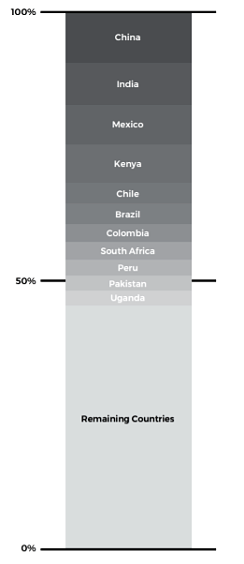

Problem Statement
Today, 650 million children around the globe are at risk of being left behind as they fail to learn basic skills. Inequitable access to education is part of the problem, but even when children are in school, they may not be learning.
FIGURE. Impact evaluations in education, by country.
Source: 3ie Impact Evaluation Repository

Slide 4


Our Solution
Software as a Service (SaaS)
Open Learning
An adaptive e-learning interactive system that personalizes and adapts e-learning content, pedagogical models, and interactions between participants to facilitates learning in an evocative and efficient way by using diversity of computing technologies.
Learning Materials: Content uploaded by an individual in all form (text, video, audio, etc.) for any subject is rated by community to filter best available content by making using processing algorithms.
Content Network Mapping: Contents are mapped with inter-connected (knowledge component graph) network to plot the shortest-path towards learning any subject deeply and efficiently.
Adaptive Learning: Individual's learning activity and up-to-date assessment system is plotted into Knowledge Graph and Learning Curves iterated until stable, to ensure flawless learning.

Slide 5


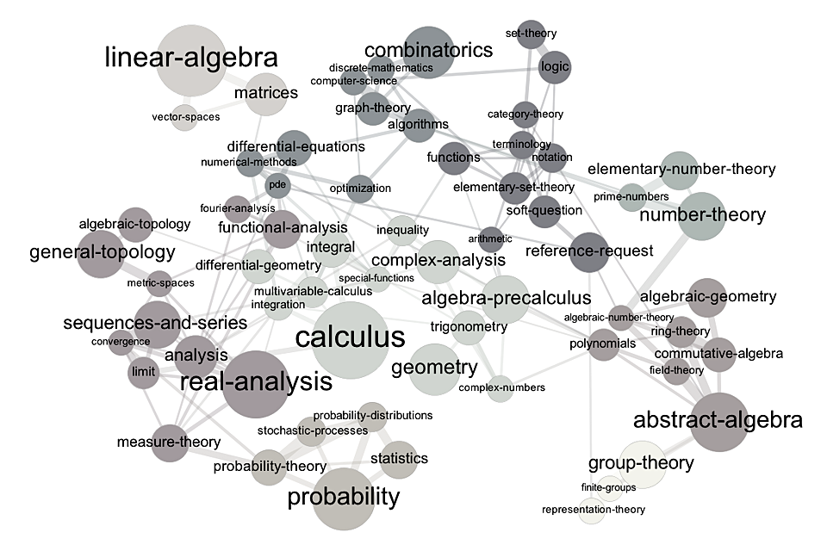

Assessment
B
How it works?
Learning Curve
B
A
Student
7
Intervention Engine
1
6
7
Adaptation Engine
Tutor
A
B
4
2
3
5
Student Information System
Student Learning Data
Predictive Model
Dashboard

Slide 6

Our Customers
Teachers & Students all around the globe.
Global e-learning is expected to reach USD 374.3 Billion by 2026.
Schools & Educational Institute can license our tool.
Only in India, over 900 universities and 40,000 colleges.
Does market need us?
Intelligent Tutoring System that aims to provide interactive and personalized learning experience, typically without interference from human teacher, to meet individual's own learning needs and preferences.
Research and Survery suggests that there is a great demand for our solution.

Slide 7

Marketing Strategy
Search Engine Optimization: Organic traffic based on strategic content development.
Digital Marketing: Campaigns and Influencer Marketing on social media platforms.
Advertisement: Google AdSense & YouTube Ads.
Consumer Acquisition Strategy
We will offer our solution for free with lifetime access to free resources along with partial access to Intelligent Adaptive Learning System.
We will offer free access for a trail period of 7 days to try our premium options.

Slide 8

Our closest & biggest competitor:
Our Competition
Squirrel AI (K12 EdTech company)
1st AI-Powered Adaptive Education Provider in China, offers Intelligent Adaptive Learning Engine developed by YiXue Education.
Focus:
Lack of Personalized Attention in Traditional Classrooms
Unequal Distribution of Educational Opportunities
Stories:
Opened over 1700 schools and has 3,000 teaching staff in more than 200 cities in China.
The three rounds of financing have helped Yixue accumulate over 100 million RMB (14 million USD).
Established an artificial-intelligence-driven education laboratory in New York, and Yixue Ai Lab.
How are we different?
We are working to achieve same or better perfection as YiXue Education's Adaptive Learning Engine.
We are open-to-all and designed to be raised by community of Teachers and Students.
With access to larger data-set to be produced by community, we can scale fater and more efficiently.
Despite freemium, our pricing are minimal, made to be affordable for all individuals.
USP is Multi-Lingual Content Processing System and Knowledge Graph.

Slide 9

Revenue Model
FREEMIUM REVENUE MODEL
Users can accees free-contents with Knowledge Graph, Learning Curves and Assessment System for free.
Premium Content with Intelligent Tutoring System and Adaptive Learning is available to paid consumers.
Pricing
Premium Membership: Rs. 299/month for Intelligent Tutoring & Adaptive Learning System
Premium Content: 30% Royality on Sales Revenue (Priced by Content Creator)
Market Size
Global e-learning Market was estimated at USD 144 Billion in 2019 and is expected to reach USD 374.3 Billion by 2026.
Projections
Our target is to acquire 5k - 7k user by the end of 1st year after launch.
Of which, we target to convert atleast 50% free users into paid users.
Under Privileged students will receive free lifetime access to maximum resources.

Slide 10

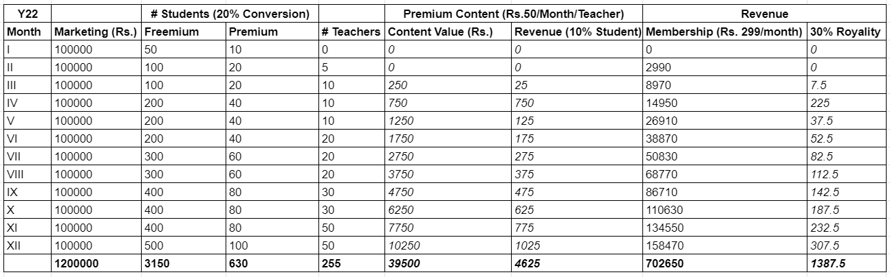
3 Years Forecast
(after β-Launch)
Financials - I
Expenses: 36.6 Lakhs
Full-Stack Developers: 2 x Rs. 35000 x 12 months = 7.2 Lakhs
AI & Data-Science: 2 x Rs. 40000 x 12 months = 9.6 Lakhs
Content Developer: 5 x Rs. 20,000/month x 12 months = Rs. 12 lakhs
Proof-Readers: 5 x Rs. 12,000/month x 12 months = Rs. 7.2 lakhs
Marketing Budget: Rs. 1 lakh x 12 months = Rs. 12 lakhs
Operating Cost: Rs. 45,000 x 12 months = Rs. 5.4 lakhs
Year I
Revenue: Approx. 7 Lakhs

Slide 11
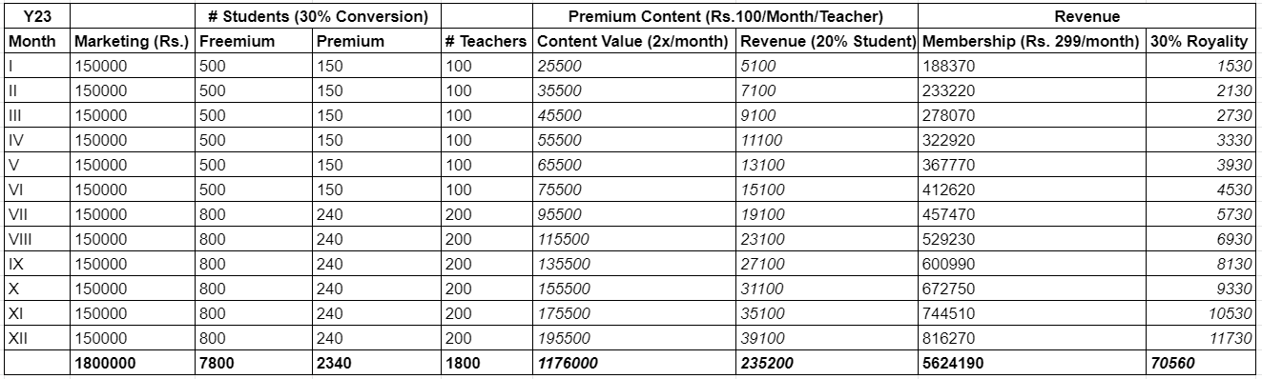
Financials - II
Expenses: 59.4 Lakhs
Full-Stack Developers: 2 x Rs. 35000 x 12 months = 7.2 Lakhs
AI & Data-Science: 2 x Rs. 40000 x 12 months = 9.6 Lakhs
Content Developer: 5 x Rs. 20,000/month x 12 months = Rs. 12 lakhs
Proof-Readers: 5 x Rs. 12,000/month x 12 months = Rs. 7.2 lakhs
Marketing Budget: Rs. 1.5 lakh x 12 months = Rs. 18 lakhs
Operating Cost: Rs. 45,000 x 12 months = Rs. 5.4 lakhs
Year II
Revenue: Approx. 57 Lakhs

Slide 12

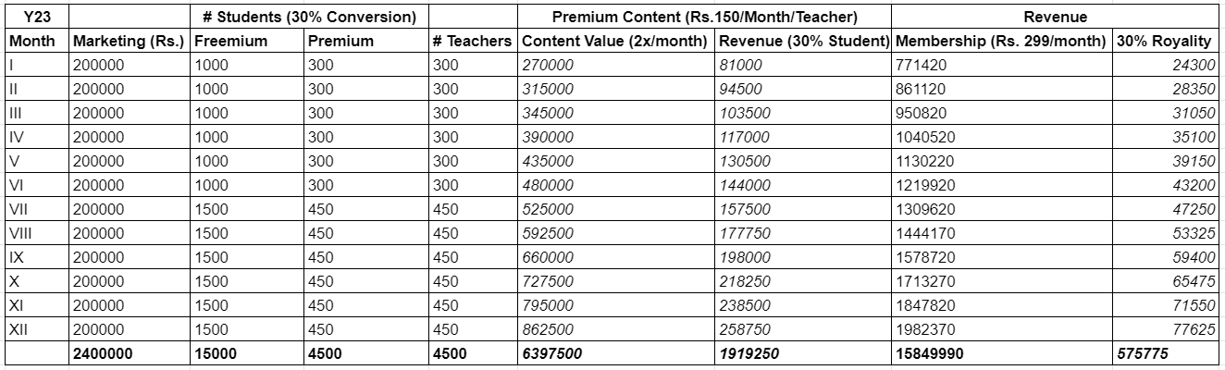
Profitable
Financials - III
Expenses: 65.4 Lakhs
Full-Stack Developers: 2 x Rs. 35000 x 12 months = 7.2 Lakhs
AI & Data-Science: 2 x Rs. 40000 x 12 months = 9.6 Lakhs
Content Developer: 5 x Rs. 20,000/month x 12 months = Rs. 12 lakhs
Proof-Readers: 5 x Rs. 12,000/month x 12 months = Rs. 7.2 lakhs
Marketing Budget: Rs. 2 lakh x 12 months = Rs. 24 lakhs
Operating Cost: Rs. 45,000 x 12 months = Rs. 5.4 lakhs
Year III
Revenue: Approx. 1.63 Cr.

Slide 13

Building Prototype
[CURRENT STAGE]
Current Stage & Milestones
Continious Marketing
Digital Marketing
Scale
Solution & Users
Testing
30th October
Planning, R&D, Coding
[Achievied]
α - Launch
30th December
Target: ~50 Users
β - Launch
1st January, '22
Target: ~100 Users / month
Prototyping
September 30th
Content Developer
(3 - 5 Teachers)
TestFlight Users
(5-10 Students)
Mobile App. Development
1st Febuary, '22
Hire Content Developers

Slide 14

Team
Rahul Yumlembum
Pursuing PhD Artificial Intelligence & Security
Former Project Fellow, IIT Guwahati
Former Co-Founder of Loony Mart
Shiva Chettri
Technical Head at Codigion
10+ Year in IT & Software Development
Former Co-Founder at Loony Mart
Melvinson Khongphai
4+ Year in IT & TeleCom
Founder of MegSol
Founder of MegJob
Vidhi Sharma
Pedagogue for 5+ Years
Content Developer
Naveen Kumar
UX/UI | 7+ Years
Bibhav Gewali
Full Stack & App. Development | 4+ Years
Deepak Kuwor
Full-Stack | ~1 Year
Som Upadhaya
Full-Stack | ~1 Year

Slide 15

Fundraising
Investment:
Approx. 3.5 lakhs in 8 months.
Funds available for next 12 months, via IT and Software development service.
Funding Requirement & Use of Fund:
Need to raise Rs. 31.2 lakhs for 12 months, to launch and start generating revenue.
Funds to be used as:
Content Developers: 5 x Rs. 20,000/month x 12 months = Rs. 12 lakhs
Proof-Readers: 5 x Rs. 12,000/month x 12 months = Rs. 7.2 lakhs
Marketing Budget: 1 lakh x 12 months = Rs. 12 lakhs

Slide 16


MEGHALAYA
We wish to work with Schools and Colleges in Meghalaya to uplift our state among Top States in the country in STEM Education.
Our SaaS product will be multilingual starting from English and Khasi.

Slide 17

Codigion (c) 2021
Tarka Yanta Software (OPC) Pvt. Ltd.
Thank You!

Slide 18

Citations & References
Joshi, A., Allessio, D., Magee, J., Whitehill, J., Arroyo, I., Woolf, B., Sclaroff, S. and Betke, M., 2019, May. Affect-driven learning outcomes prediction in intelligent tutoring systems. In 2019 14th IEEE International Conference on Automatic Face & Gesture Recognition (FG 2019) (pp. 1-5). IEEE.
Hussaan, A.M. and Sehaba, K., 2014, April. Learn and Evolve the Domain model in Intelligent Tutoring Systems: Approach based on Interaction traces. In 7th International Conference on Computer Supported Education (CSEDU'14) (pp. 197-204).
Samantha Custer, Elizabeth M. King, Tamar Manuelyan Atinc, Lindsay Read and Tanya Sethi. Towards Data Driven Education System, Feb. 2018.
Kika, A., Leka, L. and Loka, E., Adaptive Learning and Testing in Moodle.
Squirrel AI: Learning by Scaling - by Jeffrey M. Conn and Stephen Ciesinski

